Slide 1
CICD with JENKINS
MOHAMED SWELAM

Slide 2
Timeline
DAY 1
JENKINS INTRO
DAY 2
ADVANCED PIPELINE
DAY 3
ADMINSTRATION
INSTALATION
CICD CONCEPT
JENKINS SHARED LIB
SSO IN JENKINS
SECURITY
SUMMARY
PROJECT

Slide 3
Agenda for DAY 1
Introduction to CICD
CICD popular tools
What is jenkins
Jenkins architecture
Installation demo
Gui journey
Pipelines types
Summary

Slide 4
Introduction to CICD
“Continuous Integration is a software development practice where members of a team integrate their work frequently, usually each person integrates at least daily - leading to multiple integrations per day. Each integration is verified by an automated build (including test) to detect integration errors as quickly as possible” – Martin Fowler

Slide 5
Introduction to CICD
Continuous deployment is a strategy in software development where code changes to an application are released automatically into the production environment. This automation is driven by a series of predefined tests. Once new updates pass those tests, the system pushes the updates directly to the software's users.

Slide 6
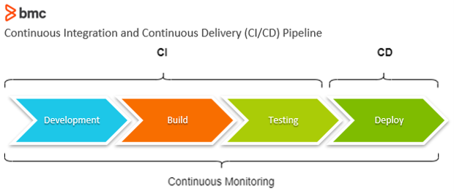

Slide 7

What is Jenkins

Slide 8
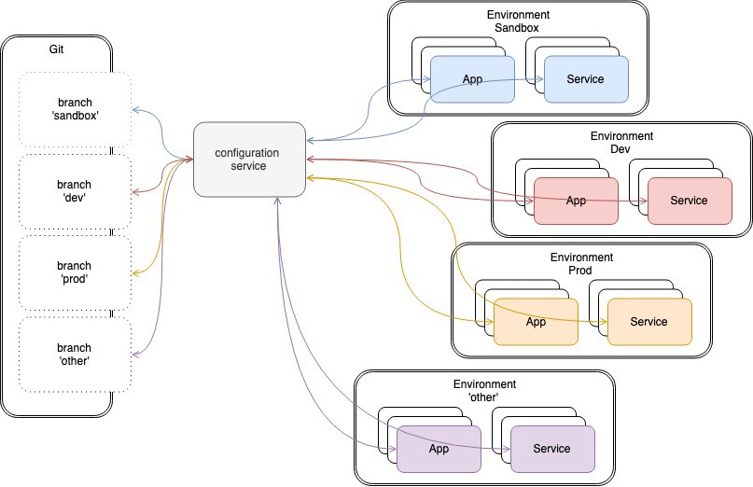

Slide 9
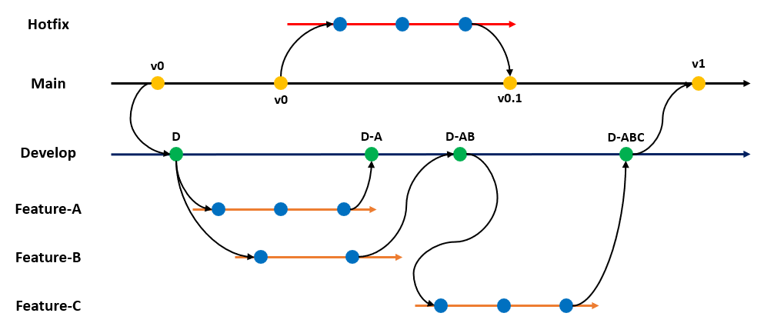

Slide 10
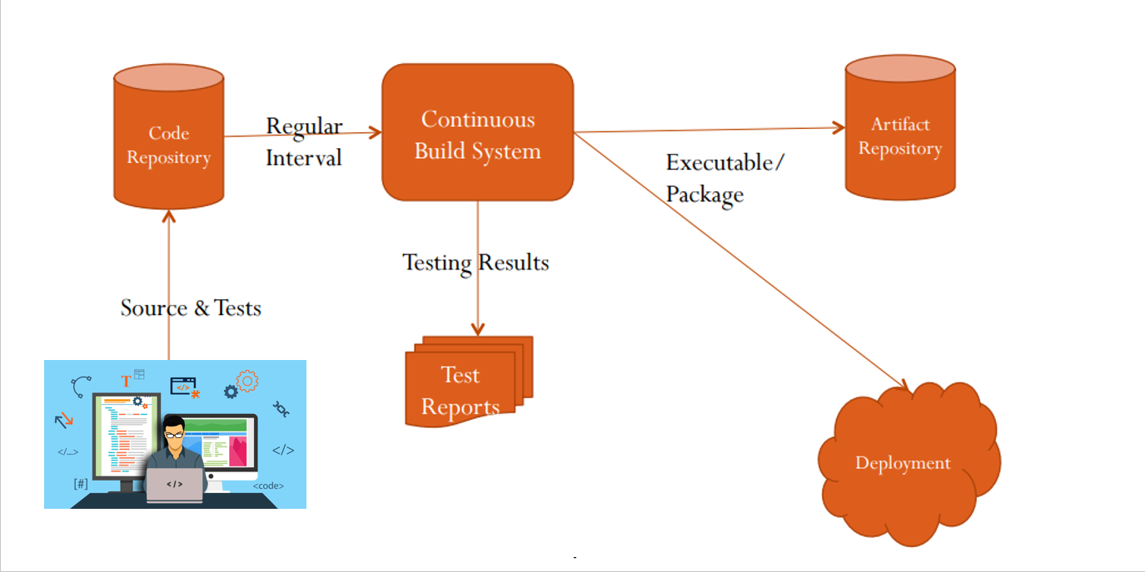

Slide 11
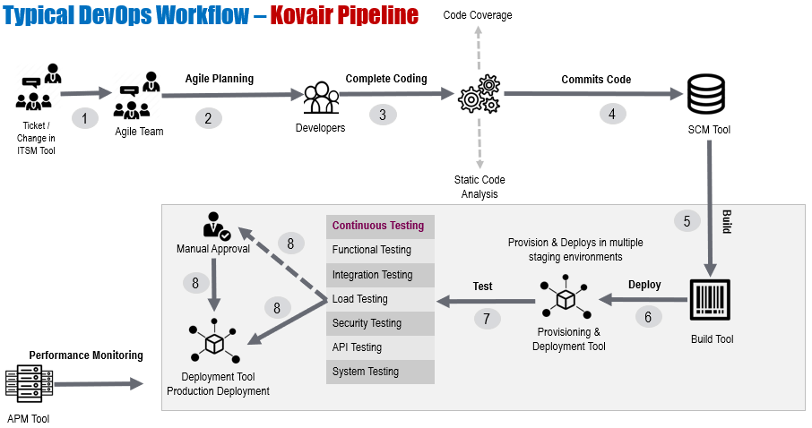

Slide 12


Slide 13
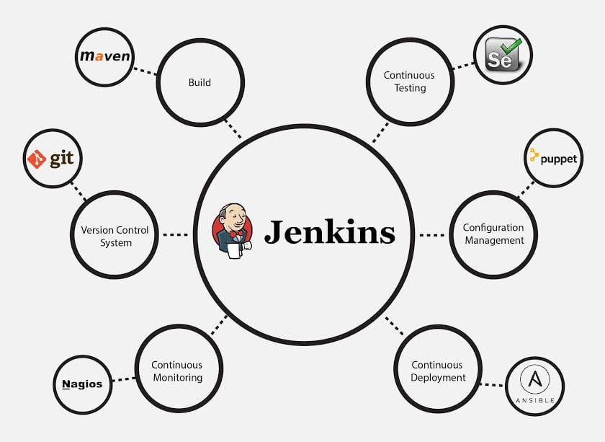

Slide 14
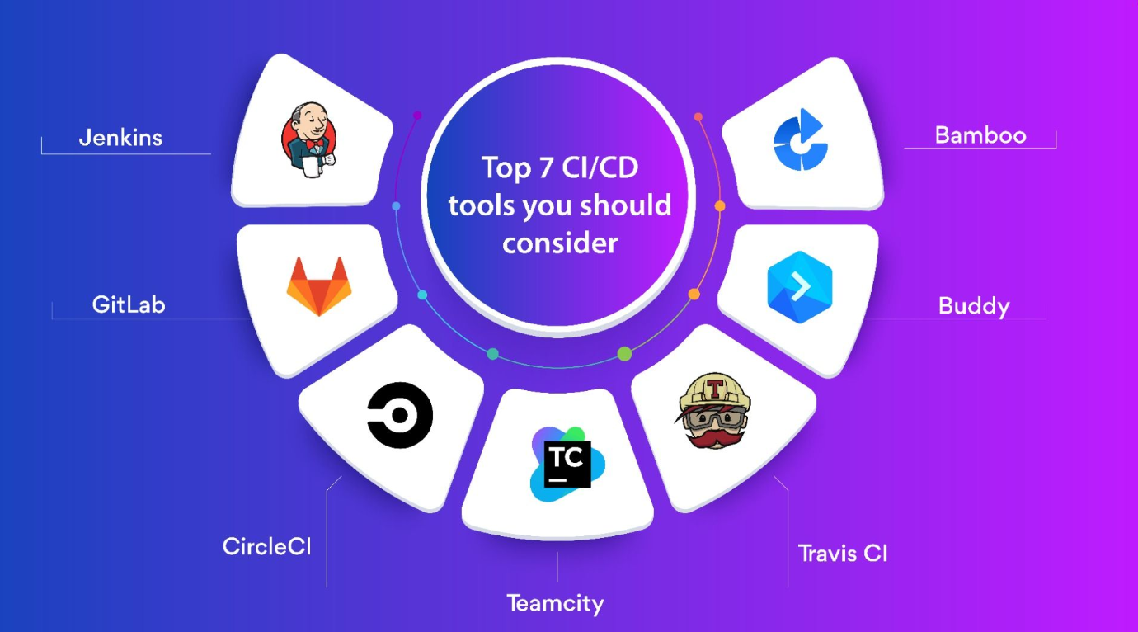

Slide 15
What's Jenkins
Jenkins is an open source continuous integration/continuous delivery and deployment (CI/CD) automation software DevOps tool written in the java programming language. It is used to implement CI/CD workflows, called pipelines.
Pipelines automate testing and reporting on isolated changes in a larger code base in real time and facilitates the integration of disparate branches of the code into a main branch. They also rapidly detect defects in a code base, build the software, automate test of their builds, prepare the code base for deployment (delivery), and ultimately deploy code to containers and virtual machines, as well as bare metal and cloud servers

Slide 16
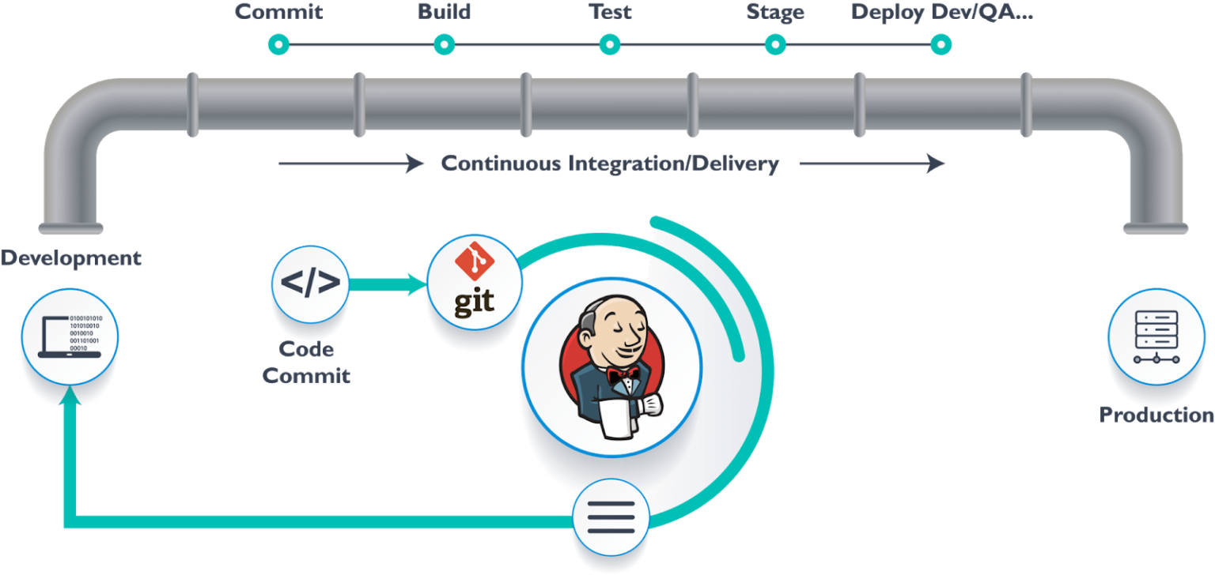

Slide 17
Jenkins history
Jenkins is a fork of a project called Hudson, which was trademarked by Oracle. Hudson was eventually donated to the Eclipse Foundation and is no longer under development. Jenkins development is now managed as an open source project under the governance of the CD Foundation, an organization within the Linux Foundation.
Continuous integration has evolved since its conception. Originally, a daily build was the standard. Now, the usual rule is for each team member to submit work, called a commit, on a daily (or more frequent) basis and for a build to be conducted with each significant change. When used properly, continuous integration provides various benefits, such as constant feedback on the status of the software. Because CI detects deficiencies early on in development, defects are typically smaller, less complex and easier to resolve.

Slide 18

Why Jenkins?
Jenkins is an open-source tool with great community support
Jenkins is easy to install
GUI configuration
Jenkins has 1000+ plugins to ease your work and also you can code your own and share it with community
Jenkins is free of cost
Jenkins is build with java and hence, it is portable to all the major platforms
Pipelines scripts (jenkinsfile) is written with groovy language which is easily to integrated with bash scripts

Slide 19
What you can do with Jenkins
Run tests
Build artifacts
Publish artifacts
Deploy artifacts
Send notifications
Etc ….

Slide 20
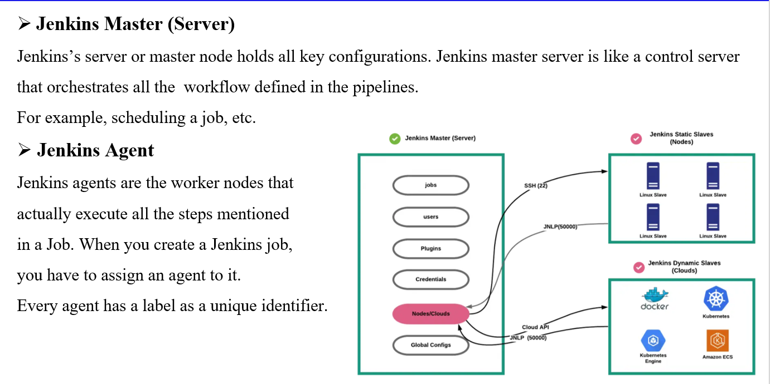
Jenkins architecture

Slide 21
Installation demo

Slide 22
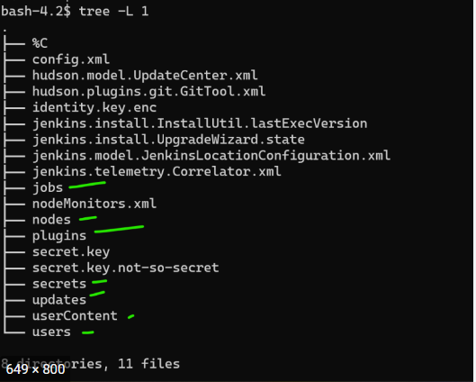
Jenkins hirarchy

Slide 23
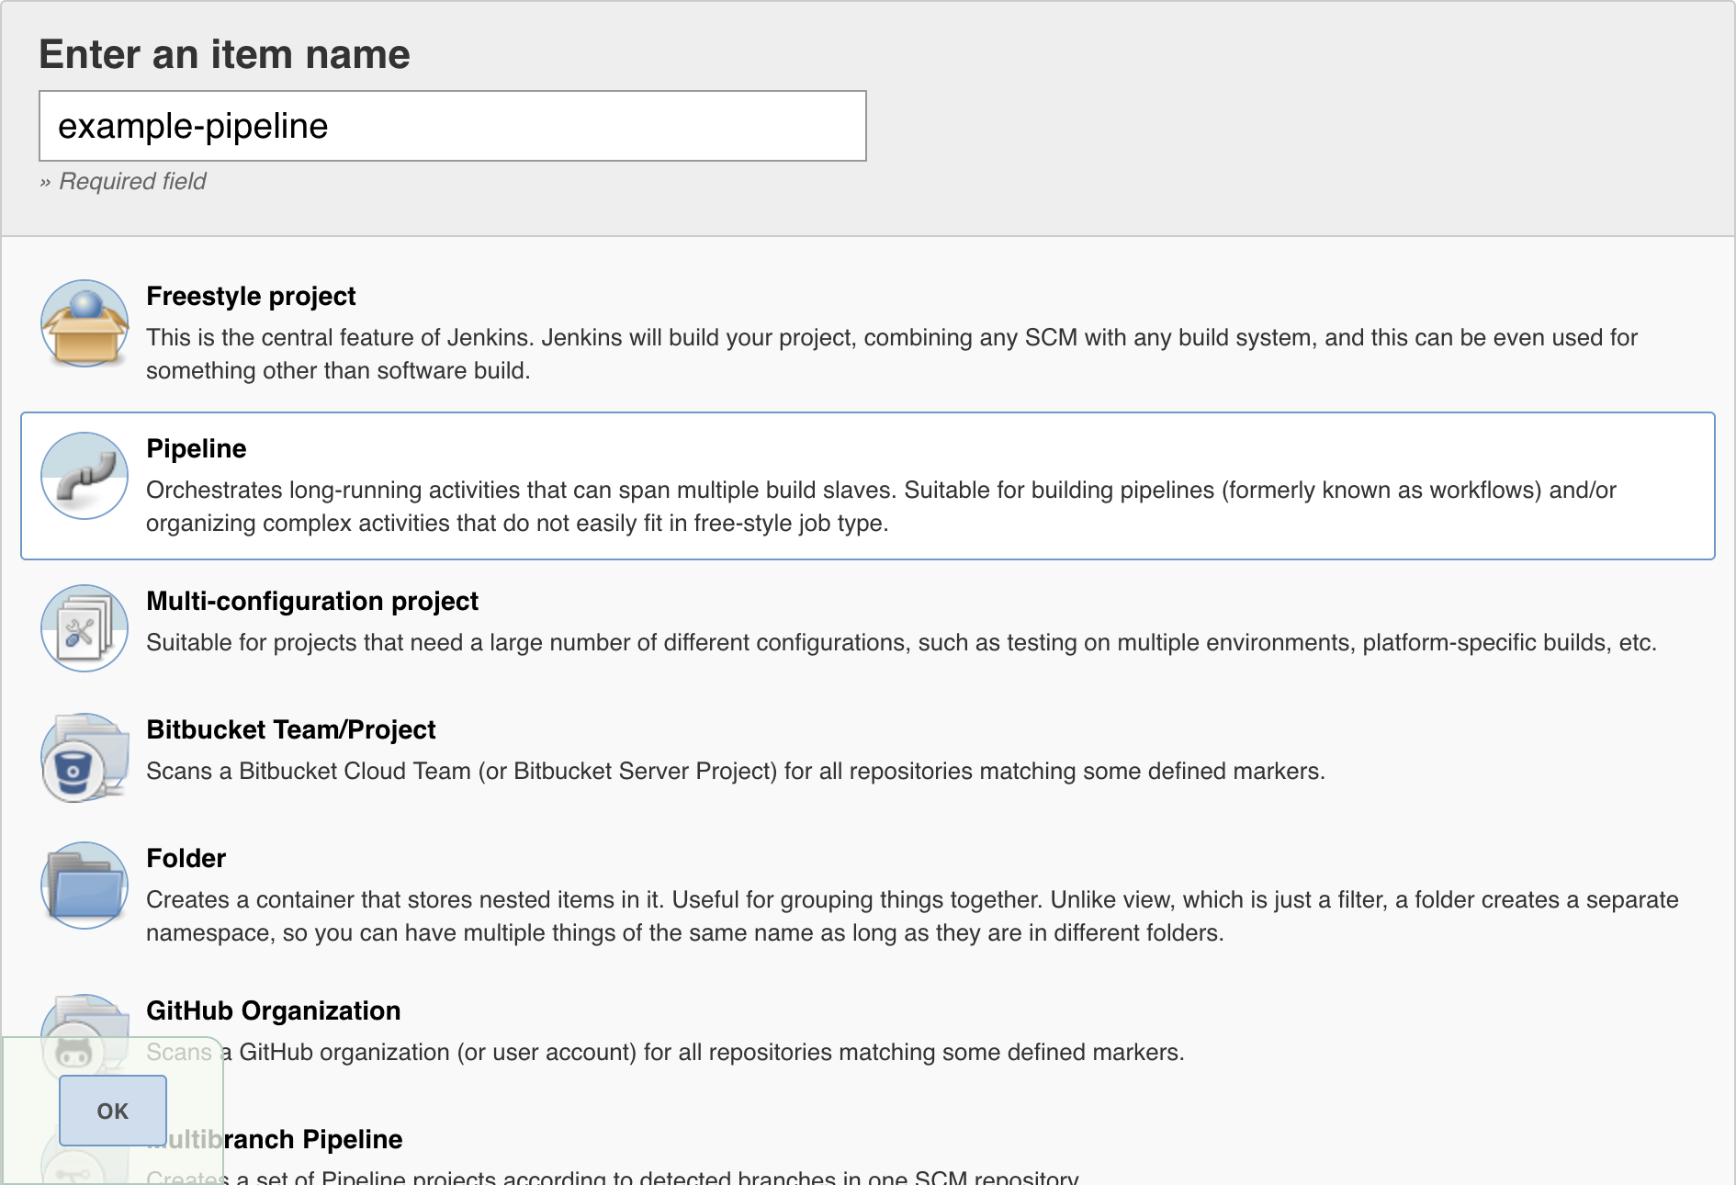
Jenkins pipeline types

Slide 24
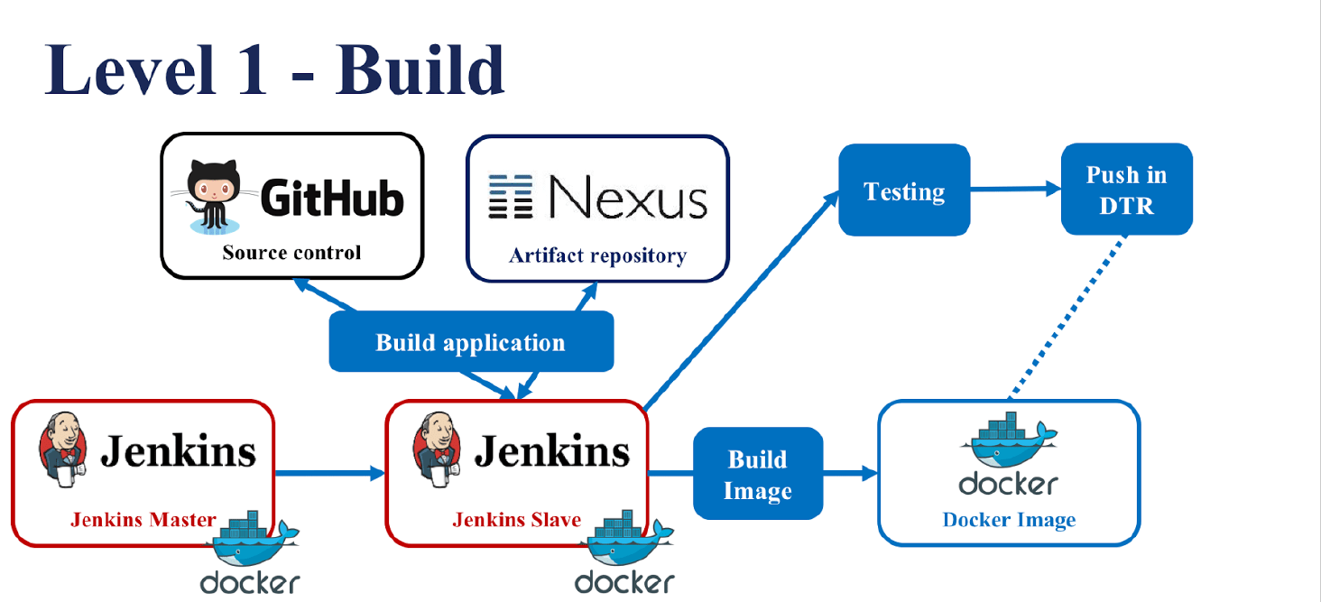
Typical Jenkins workflow
nexus

Slide 25

How to publish artifact on non secure nexus?
nexus

Slide 26

Plugins
Jenkins plugins

Slide 27
Summary

Slide 28
Thank you
Mohamed Swelam
Mohamed.swelam95@gmail.com
01092844600

